Slide 1
Final Review
PROBLEM STATEMENT : To Render 3D views into 2D images and then stitching this multiple rendered images/frames to form a smooth coherent video
Intern Name : Rishi Jaiswal Mentor Name : Anoop Kolar Rajagopa Team / Group / Part : Immersive XR / XR Perceptions / 3D Interactions College / Branch : IIT Kanpur / BT Electrical 2nd July, 2024 SRI-B, INDIA

Slide 2
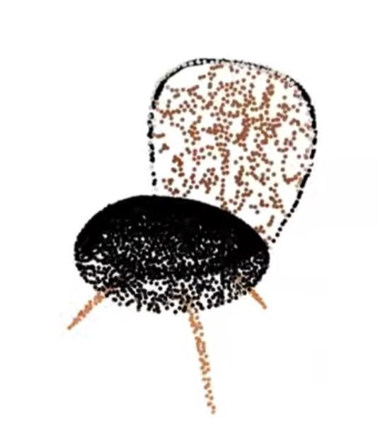
Input
A 3D point cloud representation (Here it is a chair)

Slide 3

Output
The Image of the chair.

Slide 4
What we are trying to do?
Here we are converting the 3D points cloud representation of a scene into 2D image.

Slide 5
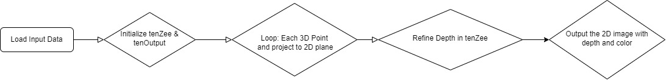
How are we doing this?
Input data is the 3D point Cloud, tenZee stores the depth values of output image, tenOutput is the output image. Basic Working of the algorithm

Slide 6
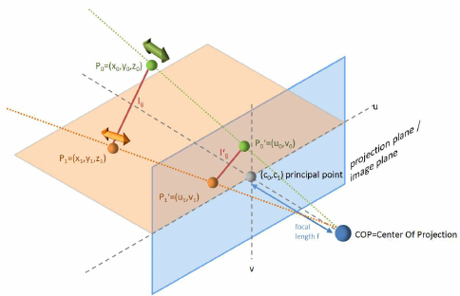
representation of projection of 3D points on 2D plane

Slide 7
Point cloud rendering (3D pointcloud to 2d images)
Limitations : 1) Division by zero occurs in multiple places (e.g., fltDistance = fltNumerator / fltDenominator). Specific input data can cause fltDenominator to be zero, leading to crashes or unexpected behavior.
2) Sometimes produces geometric distortions due to incorrect projections.
3) Launching multiple kernels and utilizing atomic operations can be computationally expensive. Uses of the this technique : 1) Point cloud rendering can create realistic 3D overlays for AR applications. Example: Furniture placement apps using point cloud data to show how furniture would look in a room. 2) Point clouds can be used to create immersive 3D environments in VR.

Slide 8

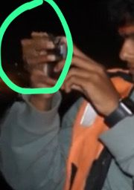
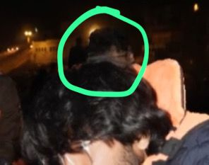
Some failed attempts
Input Image Depth Inaccuracy in Geometric measurement, poor Distortion rendering

Slide 9




Rendering : Stitching of frames
The second part of rendering is to stitch multiple 2D images to form a video, here just for explanation I took 4 images but in reality it can be more. The video link is https://youtube.com/shorts/_oDcyTzfiVA

Slide 10
Rendering : Stitching of frames
Flowchart

Slide 11
Conclusions and Challenges
1) Difficulty in detecting and rendering points accurately due to insufficient illumination.
2) High density of points can lead to occlusion and overlap, causing inaccuracies in rendering.
3) The code might benefit from optimization techniques or alternative algorithms for specific use cases, particularly to handle complex point clouds efficiently. 4) Artifacts such as geometric distortions might appear due to incorrect projections.

